Slide 1
Lecture 1
Sampling

Slide 2
Definition:
Population:
The population in a statistical study is the entire group of individuals we want information about.
How to know the information?
Conduct a census!
A census collects data from every individual in the population.
☹ Census: take too much time and cost too much money ☹
Sampling!!!!!!
Notes:
Population
Population里有N个值，每个值 叫outcome，相当于集合里的元素，population就是全集
那我们怎么可能知道population的信息呢？
可以通过census 的方式，比如我们的人口普查
但是往往census是不现实的，比如灯泡使用时间，会耗费过多的金钱和时间
那我们也可以用另一种方式收集数据，就是抽样 Sampling

Slide 3
Definition:
Population:
The population in a statistical study is the entire group of individuals we want information about.
How to know the information?
Sampling:
Choosing a subset of individuals in the population from which we collect data.
Sample:
a subset of individuals in the population from which we collect data
Notes:
Sampling 抽样指的就是 choosing a subset of individuals in the population and collect data from the subset
通过抽样我们就得到了样本sample

Slide 4
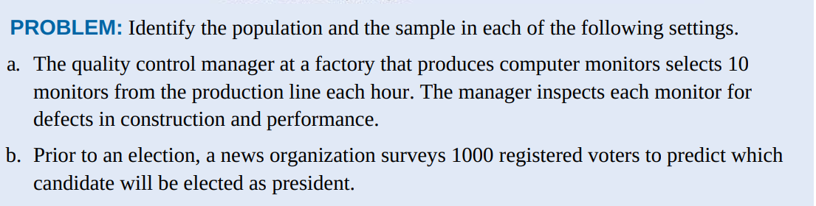
The population is all the monitors produced in this factory that hour. The sample is the 10 monitors selected from the production line.
b. The population is all registered voters.
The sample is the 1000 registered voters surveyed.

Slide 5
Sampling without replacement ~ n distinct individuals
Once an individual from the population is selected for inclusion in the sample, it may not be selected again in the sampling process.
Sampling with replacement
After an individual from the population is selected, the individual is placed back in the population and can be selected again in the sampling process.
A sample selected with replacement might include any particular individual from the population more than once.
Notes:
关于抽样，有两个概念需要同学们了解
抓阄
蓝色和红色两种小球各10个，我要选取两个个体作为样本，我先抽取一个小球是蓝色。
Without replacement 的话，我第二次抽取的还是蓝色小球的可能性就是 1/9
With 1/10

Slide 6
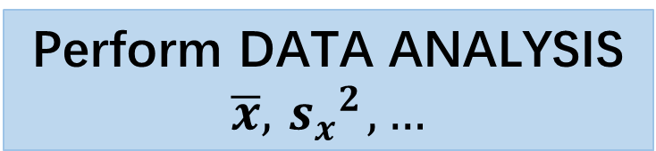
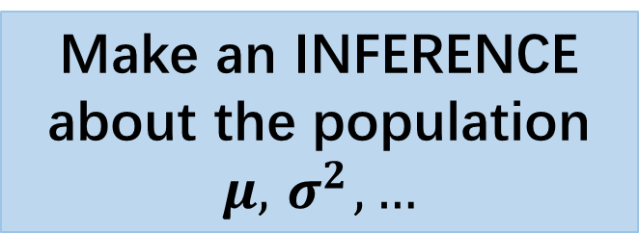
Population: x1, x2, …, xN
Census
Sample
Collect data from the sample
x1,x2, … ,xn
Sampling
Make an INFERENCE about the population
$$μ, { σ}^{2},…$$
Generalize the conclusion of the sample to the whole population
Perform DATA ANALYSIS
$$\overline{x}, { s_{x}}^{2},…$$
What we want first is the
representative sample
To get the representative sample, should control: various kinds of bias!
Notes:
如果我们想要把sample的结论推广到population，我们必须要得到一个具有代表性的样本。
所以我们首先要做的是，要找到一个 representative sample。
为了得到一个具有代表性的样本，我们要避免很多偏差 bias。
比如，我想测量咱们学校同学的平均身高，我在初中楼找样本，就不合理，我去篮球馆找也不合理，这个反例都不是具有代表性的样本，都有偏差bias。

Slide 7
How to Sample Badly (Bias)
Convenience bias
Selecting individuals from the population who are easy to reach.
Voluntary bias
Allowing people to choose to be in the sample by responding to a general invitation. E.g. call-in, text-in ……
Notes:
我们来看下都有哪些常见的偏差
Convenience 比如刚刚的例子，我去初中楼一找样本，很容易就能找到，但是并不能代表所有年级学生的数据，这样的偏差就是。。。
Voluntary：
比如有同学做一个调研，在朋友圈发问卷星链接，收集到的数据就是有voluntary bias，因为去主动填问卷的同学大多是对这个问卷的主题很感兴趣，并不能代表所有人
The Internet brings voluntary response sampling to the computer nearest you. Visit www.misterpoll.com to become part of the sample in any of dozens of online polls. As the site says, “None of these polls are ‘scientific,’ but do represent the collective opinion of everyone who participates.” Unfortunately, such polls don’t tell you much about the views of any larger population.

Slide 8
How to Sample Badly (Bias)
Convenience bias
Voluntary bias
Selection / Undercoverage bias: Some groups in the population are left out.
Measurement / Response Bias: tendency to provide inaccurate, or even false, answers to self-report questions
Nonresponse Bias: Data are not obtained from all individuals in the sample.
Wording Bias: when the wording of a question systematically influences the responses.
… …
Do you agree that
Welfare helps people to get back on their feet
Welfare pays people who don't work
Notes:
Undercoverage：
美国大选之前会有预测，比如每个房子的户主代表一个家庭投票，这样就漏掉了流浪汉。比如在社交软件收集选票信息，那很多不用手机的人，尤其是上了年纪的人的意见就会被忽略。
这种就叫…
Measurement：
调查托福成绩，有同学乱填的
nonresponse：
问卷星去邀请同学填写，也有同学不填的
Wording:
比较敏感的话题，或者有歧义的问题。
常考的就是这几个

Slide 9
Exam Tip:
Recognize the type of bias
Describe how the members of the sample might respond differently from the rest of the population
underestimate or overestimate
Example: Explain how using your statistics class as a sample to estimate the proportion of all high school students who own a graphing calculator could result in bias.
Answer:
This is a convenience bias. It would probably include a much higher proportion of students with a graphing calculator than in the population at large because a graphing calculator is required for the statistics class. So this method would probably lead to an overestimate of the actual population proportion.

Slide 10
Bias & Error
Bias is not just bad luck in one sample!!
Bias is introduced by the way in which a sample is selected or by the way in which the data are collected from the sample.
Increasing the size of the sample does nothing to reduce bias if the method of selecting the sample is flawed.
Notes:
Bias is not just bad luck in one sample!!
Error有可能是收集数据的时候记错数字了等等。
Bias形容的是由我们的抽样方法选取不当等造成的系统性误差. 是方法上的错误
所以通过认真的实验设计，我们可以避免 bias 的产生。
But if the method of selecting the sample is flawed Increasing the size of the sample does not help
那在抽样的过程中，怎么做到无偏？那就是“随机”。借助随机性来消除我们错误的主观判断。

Slide 11
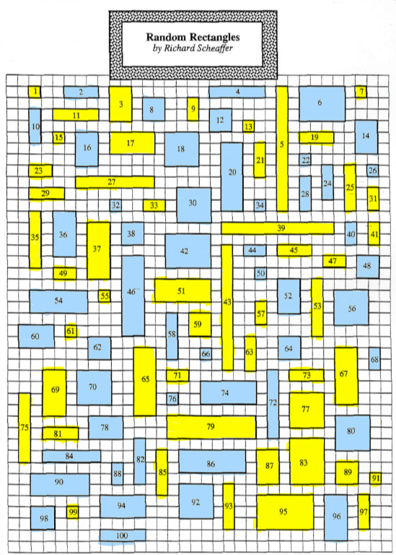

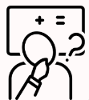
Guess
Ten seconds to guess the average area of all the rectangles.
2
7
Notes:
那么为了更好的体验随机抽样，我们一起来做一个小游戏。
请看ppt上的这个有很多黄色和蓝色长方形的图片。
图片中一共有100个长方形，标号从1到100。这里面最小的方格，他们的边长定义为1，举个例子，中间的46号长方形，它的长和宽分别为7和2。
现在请大家大胆猜测一下，这100个长方形的面积的平均值是多少。给大家十秒钟的时间，凭自己的直觉来猜测就好。

Slide 12
actual mean
5.34
Notes:
这一百个长方形的面积的均值是 5.34
偏差还是蛮大的，所以我们光凭主观猜测，得到的估计值是不可信的。
那怎么得到科学靠谱的估计值呢？用的就是随机抽样法，在随机抽样方法中，最常见的是简单随机抽样法 SRS。

Slide 13
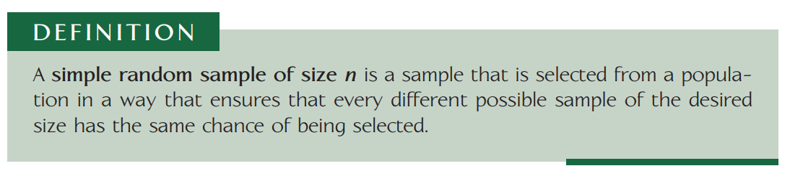
SRS（ Simple Random Sampling ）
- objective
- free of selection bias
Notes:
我们来看一下用随机抽样的办法是否会得到更好的估计，随机抽样里最简单的就叫做SRS
Def
Population里的每一个individual都有同样的机会被选去做sample。
这个办法就可以消除偏差，
比如书对于调查平均身高的例子，无论高矮，都有同样的几率被选中作为样本。

Slide 14
How to choose a SRS using Table of Random Digits
Label.
Give each member of the population a distinct numerical label with the same number of digits. Use as few digits as possible.
Randomize.
Read consecutive groups of digits of the appropriate length from left to right across a line in the table.
Ignore any group of digits that wasn’t used as a label or that duplicates a label already in the sample.
Stop when you have chosen n different labels.
Select.
Choose the individuals that correspond to the randomly selected integers.
Notes:
给population里每个人标个号，比如我想调查一百位同学的平均身高：
00,01，。。。，99
用随机数表生成10组数据，这里如果要保证每个individual都相同的可能性被选作样本，要without replacement还是with？ 要with
但是如果sample size 小于 population size 的10%，就可以用without，因为这种情况下，with和without得到的结果几乎一致。我们现实中都是without replacement居多，因为不可能选一位同学再让他回去，然后再选，一般都是直接选取一堆。
Read consecutive groups of digits of the appropriate length from left to right across a line in the table.
Ignore any group of digits that wasn’t used as a label or that duplicates a label already in the sample.
Stop when you have chosen n different labels.
所以我们在读表的时候要忽略重复的数
最后因为我们要得到样本本身，所以我们要select the corresponding individuals

Slide 15

Guess
Ten seconds to guess the average area of all the rectangles.
SRS
(Simple Random Sampling)
Generate 10 random numbers using the random number table.
Select the corresponding rectangles and record their areas.
Find the mean area of 10 rectangles.
Notes:
Generate 10 random numbers using the random number table.
比如 Using the line of 101
Select the corresponding rectangles and record their areas.
Find the mean area of 10 rectangles.
这个均值就是对于100个长方形的面积的均值的估计值

Slide 16
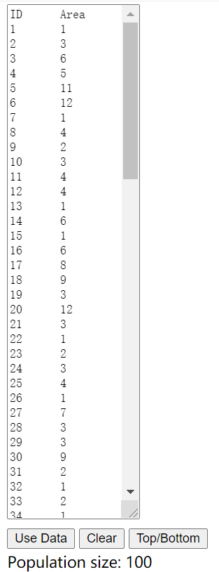
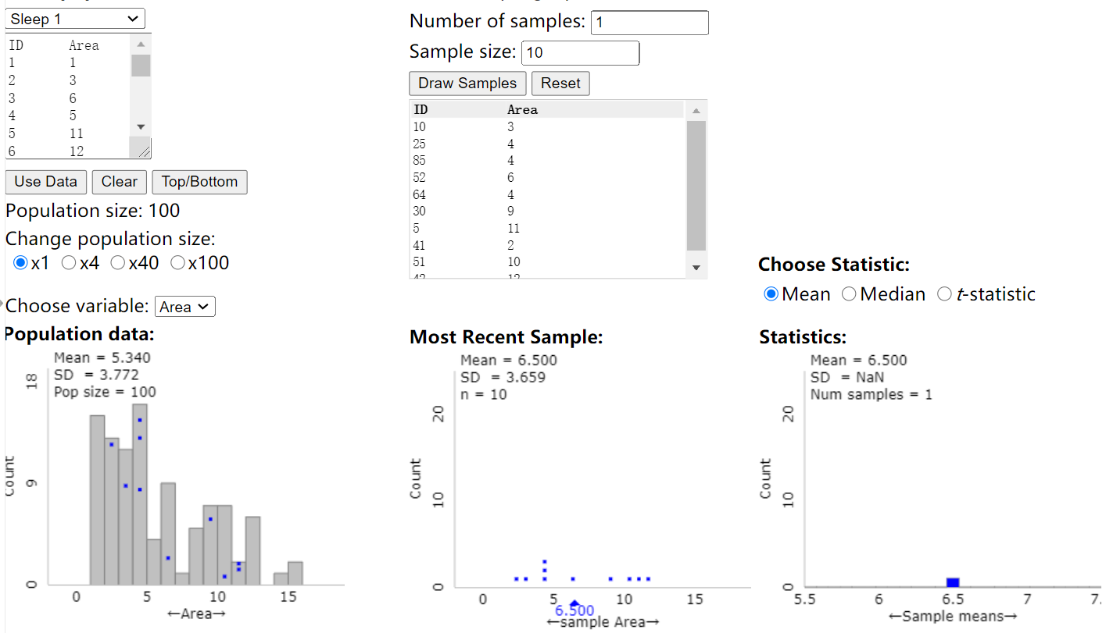
The data of 100 rectangles.
Draw one sample
One sample includes 10 rectangles
Ten areas of the sample
10 Random Numbers
We will have a mean area from a sample.
Notes:
这个是100个长方形的数据，分别为他们的标号和对应的面积
接着就开始了抽样的环节，我从100个长方形中抽取10个长方形作为我的样本。
抽样的方法就是随机抽样法。
首先，我从1-100抽取10个随机数
接着，找到了对应的10个长方形以及他们的面积值
这10个面积会产生一个均值，是6.5。
至此我们就得到了一个估计值。

Slide 17
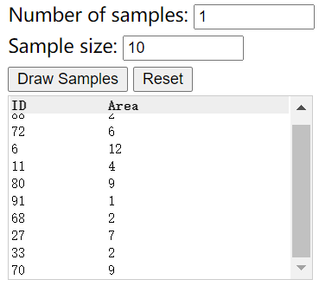
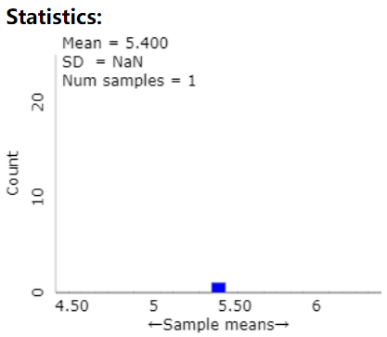
Draw one sample
We have one estimate.
Notes:
抽取一个样本，可以得到一个估计值

Slide 18
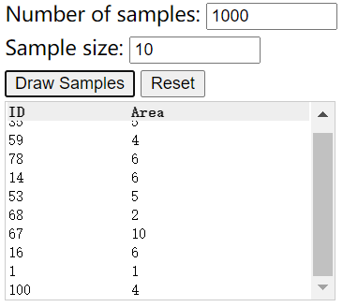
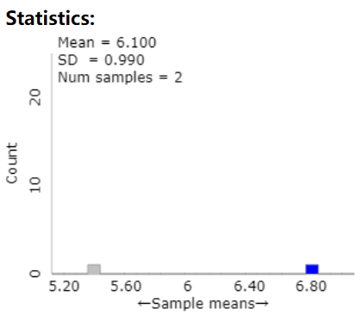
Draw another sample
We have two estimates now.
Notes:
那抽取2个样本就得到了2个估计值

Slide 19
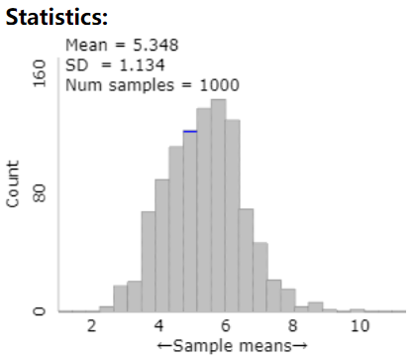
Draw 1000 samples
Draw 1000 samples
Actual value 5.34
the distribution of 1000 estimates
Notes:
抽取1000个样本，我们就得到了一组估计值，我们发现估计值几乎就是围绕着真实值5.34附近波动的。
在统计学中，当统计量的估计值围绕着它的真实值波动时，我们就称这个估计值为无偏估计量。
那有老师可能有疑问，用随机抽样好像也有可能得到不是很准确的估计值。那随机抽样的意义是什么呢？
我用一张图来解释一下。

Slide 20
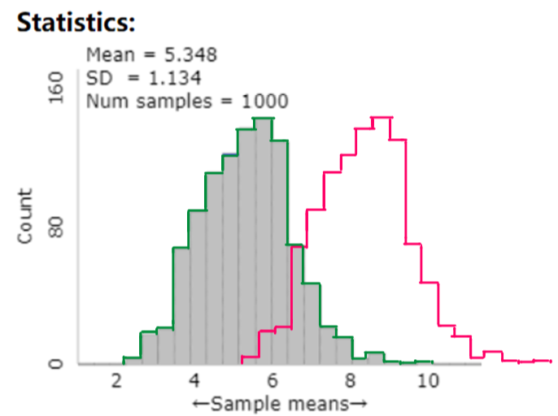
Actual value 5.34
Notes:
同样是1000个样本，左侧的绿色的是无偏估计量的分布，右侧粉红色的是有偏估计量的分布。
这么一看，由随机抽样得到的无偏估计量是比较可靠和科学的。

Slide 21
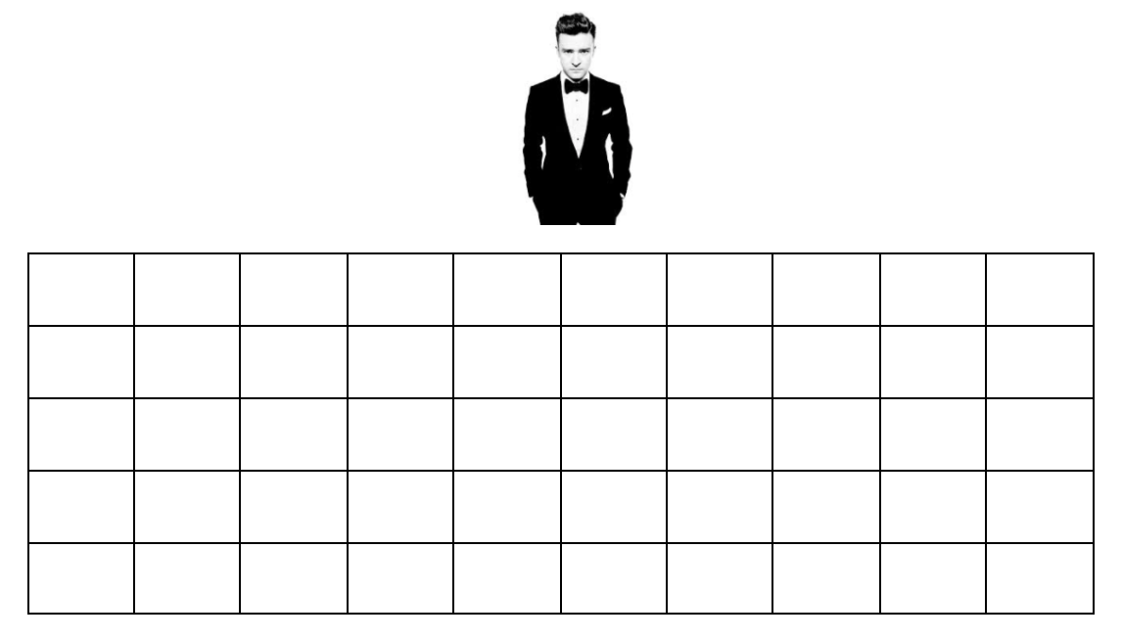
How Much Do Fans Love Justin Timberlake?
JT’s concert promoter wants to find out how much fans enjoy the concerts. He will ask fans, “From 1 to 100, where 100 is the most, how much did you enjoy the concert?” The section he wants to survey has 50 seats (5 rows x 10 columns).
The stage runs along the northern edge of the
venue (where Justin is pictured).
He wants to take a sample of 10 seats.
Take an SRS of 10 fans.
Explain the steps you used to
obtain an SRS.

Slide 22
How Much Do Fans Love Justin Timberlake?
Label seats from 01 to 50 (starting from the upper-left corner and ending at the lower-right corner).
Use the random number table to select 10 numbers, ignoring repeats and numbers with value of 51, 52, …, 98, 99, 00.
Select person in corresponding seat.

Slide 23
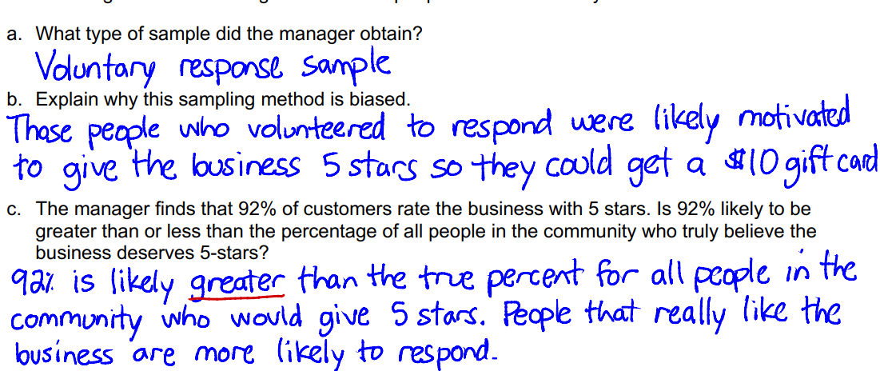

Slide 24
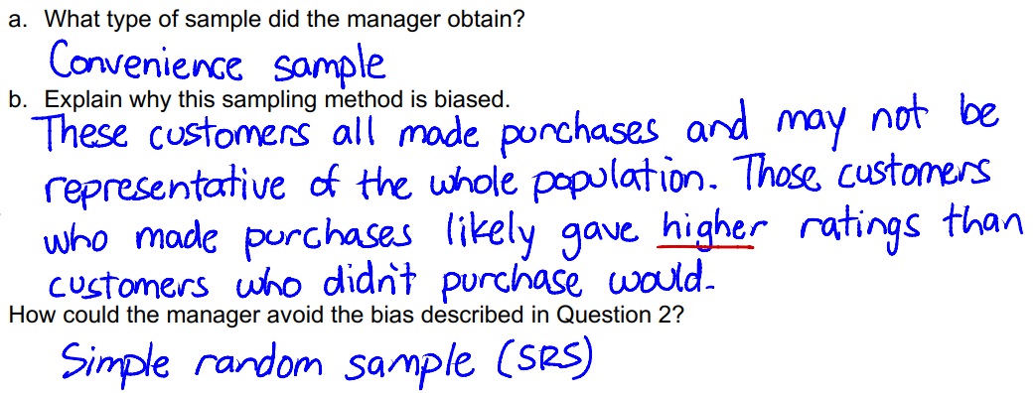

Slide 25
Other probability sampling methods
1. systematic sample
- randomly choose some starting point;
- select every k^{th} element in the population.
- easier than random sampling;
- guarantees that sample is taken from throughout the population.

Slide 26
2. cluster sample
- divide the population into sections or clusters (mutually exclusive)
- randomly select a few of those sections and then choose all members from the selected sections
- faster way to obtain sample
When to use this method:
- clusters are relatively heterogeneous, i.e. the population should contain distinct subpopulations of different types.

Slide 27
3. stratified random sample
- the entire population are divided into a set of nonoverlapping
subgroups (strata)
- draw a random sample from each stratum
Purpose:
- the sample is more representative than a SRS might be
- might be interested in results from separate strata.

Slide 28
Sampling
The entire group of individuals that we want information about is called the __________.
A census is an attempt to gather information about____________
_________________________________.
Problems with census:_________________________________________. A _____ is a part of the population that we actually examine in order to gather information.
The _________________ refers to the method used to choose the sample from the population.
The design of a study is biased if it ____________________________________________

Slide 29
Sampling
The entire group of individuals that we want information about is called the __________.
A census is an attempt to gather information about
_____________________________________________.
Problems with census:
A is a part of the population that we actually examine in order to gather information.
The _________________ refers to the method used to choose the sample from the population.
population
every individual member of the population
costs、time、sometimes can destroy items…
sample
design of a sample

Slide 30
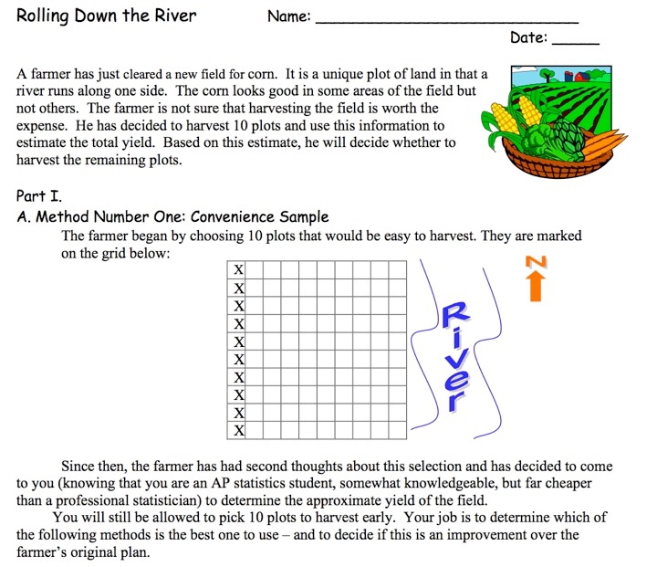
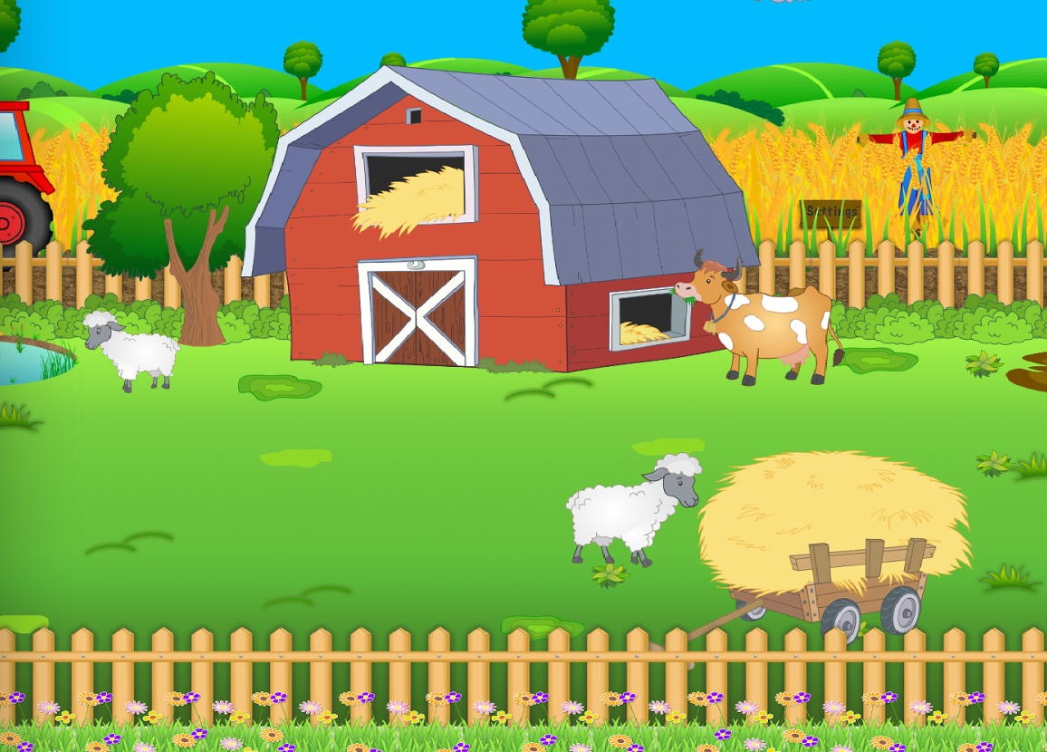

Slide 31
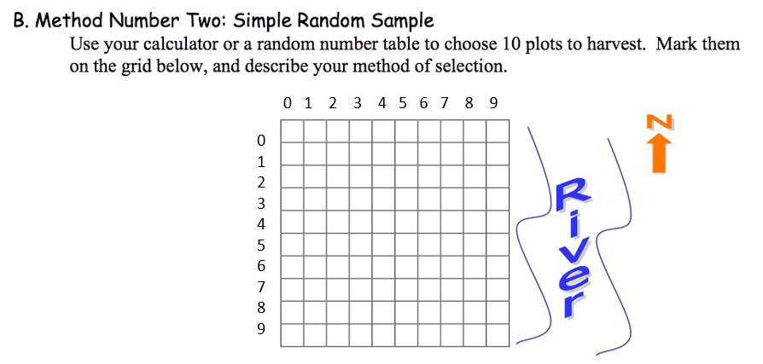

Slide 32
00 01 02 03 04 05 06 07 08 09
10 11 12

Slide 33
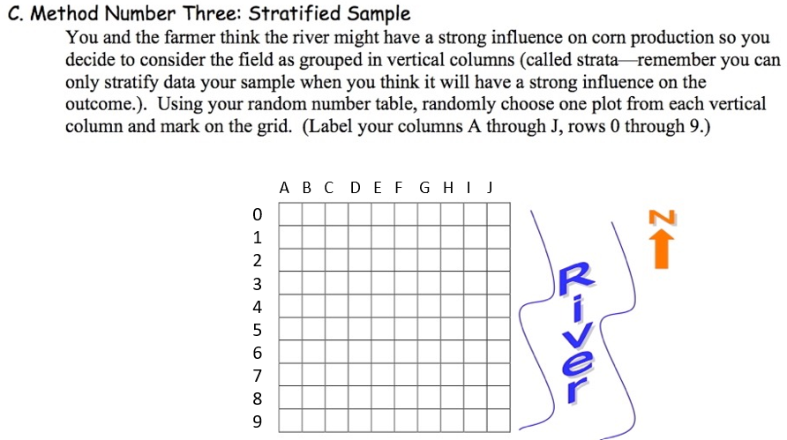

Slide 34
0
1
2

Slide 35
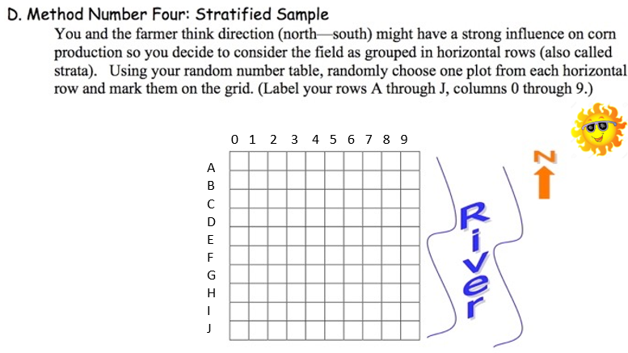

Slide 36
0 1 2
0 1 2

Slide 37
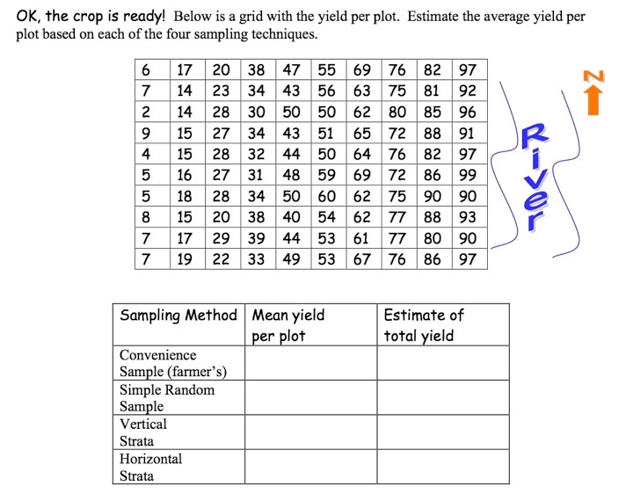
3.3
60/10=6
6x100=600

Slide 38
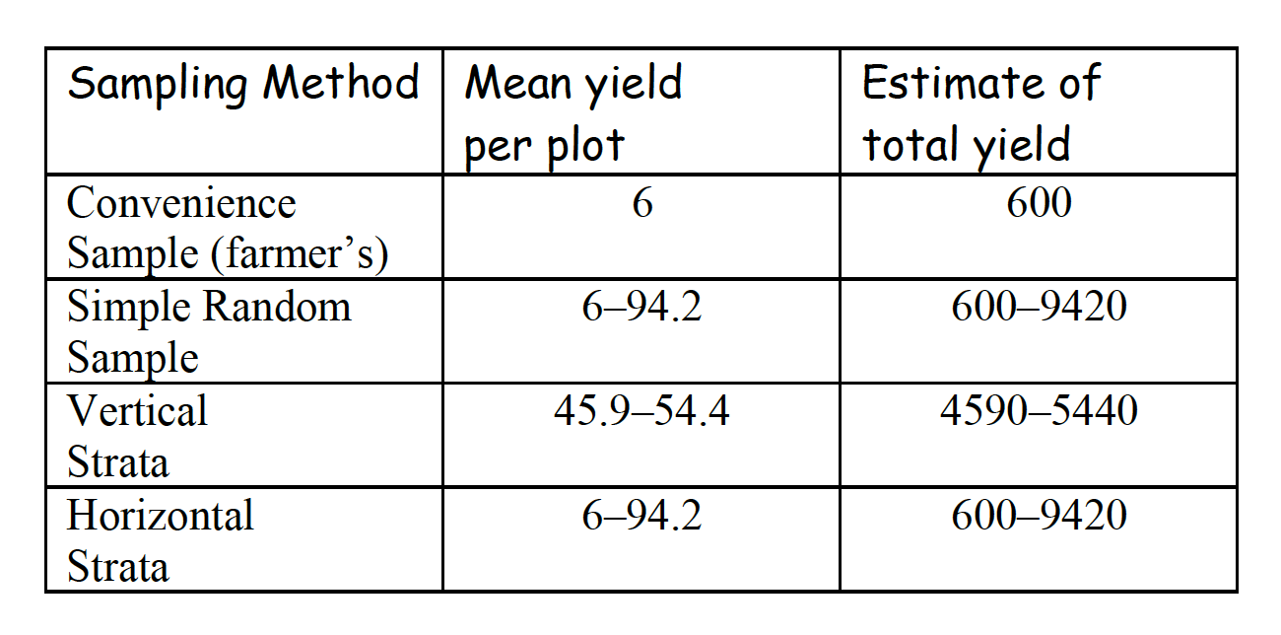
Possible yield values
actual total yield = 5004
Stratification may produce a smaller error of estimation than would be produced by a simple random sample of the same size. This result is particularly true if measurements within strata are very homogeneous – “stratification reduces variation”.

Slide 39
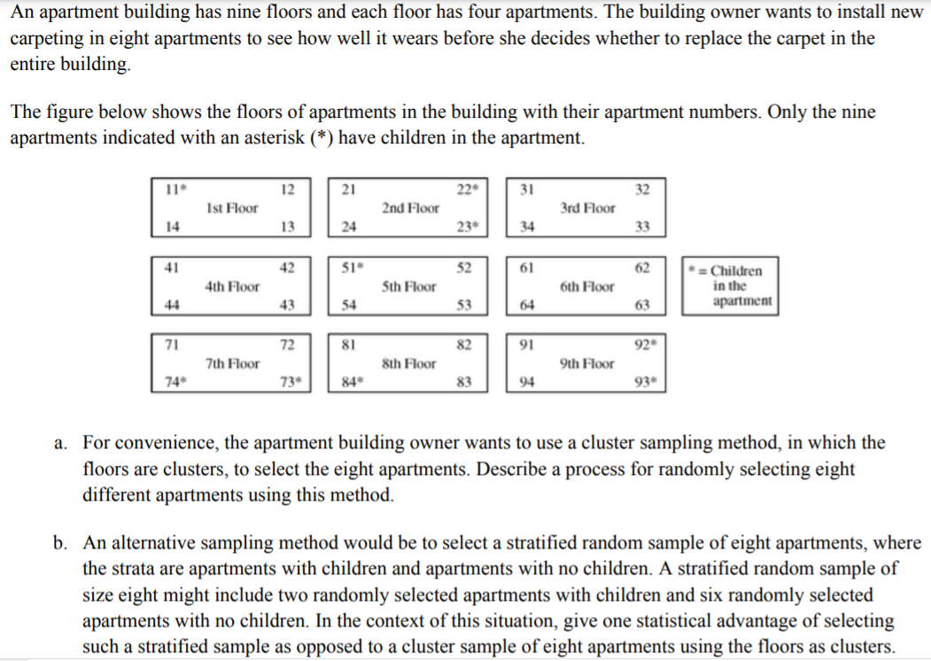

Slide 40
The following two-step process can be used to select the eight apartments.
Step 1: Generate a random integer between 1 and 9, inclusive, using a calculator, a computer program, or a table of random digits. Select all four apartments on the floor corresponding to the selected integer.
Step 2: Generate another random integer between 1 and 9, inclusive. If the generated integer is the same as the integer generated in step 1, continue generating random integers between 1 and 9 until a different integer appears. Again select all four apartments on the floor corresponding to the second selected integer.
The cluster sample consists of the eight apartments on the two randomly selected floors.

Slide 42
Because the amount of wear on the carpets in apartments with children could be different from the wear on the carpets in apartments without children, it would be advantageous to have apartments with children represented in the sample. The cluster sampling procedure in part (a) could produce a sample with no children in the selected apartments; for example, a cluster sample of the apartments on the third and sixth floors would consist entirely of apartments with no children. Stratified random sampling, where the two strata are apartments with children and apartments without children, guarantees a sample that includes apartments with and without children, which, in turn, would yield sample data that are representative of both types of apartments.

